Slide 1
Weekly Report
Prof. Huang && Shuo Zhang

Slide 2
Numenta Anomaly Benchmark
Real-time anomaly detection based on long short-Term memory and Gaussian Mixture Model, Computers and Electrical Engineering(JCR-3), 2019
Anomaly Detection for Univariate Time Series with Statistics and Deep Learning, IEEE Eurasia Conference on IOT, Communication and Engineering, 2019
FuseAD: Unsupervised Anomaly Detection in Streaming Sensors Data by Fusing Statistical and Deep Learning Models Sensor, 2019

Slide 3
Yahoo Webscope Benchmark
DeepAD: A Generic Framework Based on Deep Learning for Time Series Anomaly Detection, PAKDD, 2018
FuseAD: Unsupervised Anomaly Detection in Streaming Sensors Data by Fusing Statistical and Deep Learning Models Sensor, 2019

Slide 4
UCI
Squeezed Convolutional Variational AutoEncoder for Unsupervised Anomaly Detection in Edge Device Industrial Internet of Things, International Conference on Information and Computer Technologies, 2018
Anomaly detection with Wasserstein GAN, arXiv, 2018

Slide 5
NAB-Real Data
realAWSCloudwatch: AWS server metrics as collected by the AmazonCloudwatch service. Example metrics include CPU Utilization, Network Bytes In, and Disk Read Bytes.
realAdExchange: Online advertisement clicking rates, where the metrics are cost-per-click (CPC) and cost per thousand impressions (CPM). One of the files is normal, without anomalies.
realTraffic: Real time traffic data from the Twin Cities Metro area in Minnesota, collected by the [Minnesota Department of Transportation. Included metrics include occupancy, speed, and travel time from specific sensors
realTweets: A collection of Twitter mentions of large publicly-traded companies, such as Google and IBM. The metric value represents the number of mentions, for a given ticker symbol every 5 minutes.

Slide 6
NAB-Real Data
realKnownCause: This is data for which we know the anomaly causes; no hand labeling.
ambient_temperature_system_failure.csv: The ambient temperature in an office setting.
- cpu_utilization_asg_misconfiguration.csv: From Amazon Web Services (AWS) monitoring CPU usage.
- ec2_request_latency_system_failure.csv: CPU usage data from a server in Amazon's East Coast datacenter.
- machine_temperature_system_failure.csv: Temperature sensor data of an internal component of a large, industrial mahcine
- nyc_taxi.csv: Number of NYC taxi passengers, where the five anomalies occur during the NYC marathon, Thanksgiving, Christmas, New Years day, and a snow storm. - rogue_agent_key_hold.csv: Timing the key holds for several users of a computer, where the anomalies represent a change in the user.
- rogue_agent_key_updown.csv: Timing the key strokes for several users of a computer, where the anomalies represent a change in the user.

Slide 7
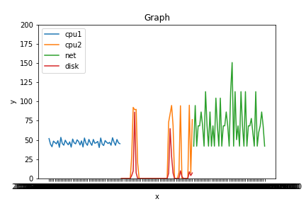
NAB-Real Data-RealASW

Slide 8
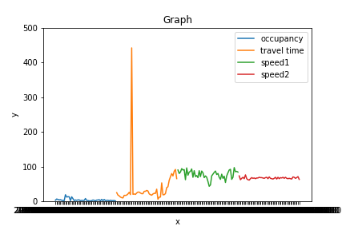
NAB-Real Data-RealTraffic

Slide 9
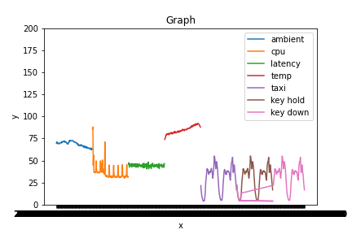
NAB-Real Data-RealKnownCause

Slide 10
NAB-Artificial Data
- artificialNoAnomaly: Artificially-generated data without any anomalies.-
artificialWithAnomaly: Artificially-generated data with varying types of anomalies.

Slide 11
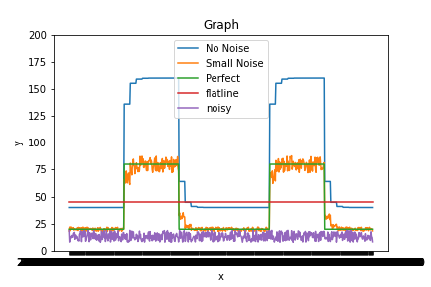
NAB-Artificial Data-No Anomaly

Slide 12
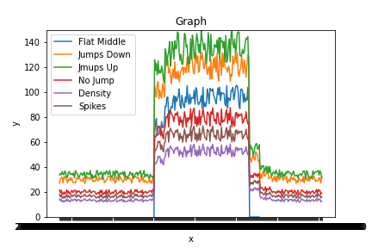
NAB-Artificial Data-With Anomaly

Slide 13
Next Week
Xiaofei Chen: apply NAB to the model
Jiayuan Chen: research on UCI and self-comparison
Qiao Jiang: other methods for comparison

Slide 14
Thanks
@MICC

